Slide 1
Bootstrap:2
Building on a foundation
Notes:
You were hand picked to be here. BS veterans who want to go deeper, or experienced CS teachers who want to learn pedagogy for Bootstrap. You each have something to offer everyone else, you all bring something unique to the table.
BS teachers - most of you are math teachers, who've mastered the BS pedagogy. You're here to learn content.
CS teachers - you know the content. you're here to learn pedagogy and a completely different approach to programming. If you’ve never done functional programming before, this is a completely new approach.
If you've seen BS:1, you know just how high a bar we set for ourselves in terms of polish. This isn't quite there yet - we have a strong foundation, and we’re excited to share it with you.

Slide 2
Bridging to CS
K-12
Looooong bridge
Algebra still key
College/AP/Industry
C-like syntax
Programming, not hacking
Notes:
Building a Bridge
We can imagine the spectrum of computer science education as a bridge. The goal of many K-12 CS courses is to get kids to reach this right side of the bridge- maybe/for some that’s AP CS in high school, taking CS classes in college, or going to work for a major tech company. For all of us, the right side of the bridge means more rigorous CS.
This side tends to use languages like Java, C, maybe Python.
Last 20 years, big cultural shift- it used to be at major tech companies, (MS, IBM, etc.) programmers were judged based on how many lines of code they wrote or the number of bugs fixed, and fixing them quickly was important.
For any of you in audience who have rushed through code and then spent 10x as much time debugging than it would have taken to solve problem in first place, you know this isn’t sustainable. And this is what tech companies grew to learn.
If you walk into your Google interview and say you know Java, they won’t care. It’s not enough to write code, your interviewer wants to see that you can write software. And that means skills that aren’t just about coding:
Writing unit tests
type specifications
documentation
20 years ago, on the left side of the bridge….
So now kids are on this bridge and saying I love Scratch, I’ve gone through hour of code, what's next?
Now we face 2 problems: 1) It’s a long way across this bridge between dragging blocks in Scratch and doing more rigorous programming in Java.
2) Maybe we’ve solved CS engagement issue, but if kids are still failing math they’re not graduating HS, and if they’re weak on important algebraic concepts like functions, in most schools they’re not able to enroll in AP chemistry, Physics, OR AP CS.

Slide 3
Bridging to CS
K-12
Engaged students
Bootstrap:1
“What’s next?”
College/AP/Industry
C-like syntax
Programming, not hacking
Notes:
In BS1, we took engaged kids and taught them Racket, rigorous software engineering habits in an algebra class.
First PD workshop in 2011 Houston, TX
Thanks to teachers like you we’ve grown and now serve 15k students, fortunate to continue our research
Great results- we can show transfer from algebraic programming to an increase in algebra performance
As students cross the bridge they have to change syntax, semantics (objects don’t work the same in one language as another) they have to change tools (if you’ve switched from Visual Studio to Eclipse knows there’s a learning curve), and we have to change curriculum (a problem solving approach in one class might be totally different than the approach taught in another)
Each of these cause friction, and if you’re a really motivated kid that already wants to be a computer engineer, you’ll be able to handle it. But who do you think are the kids hurt most, and most likely to fall off the bridge?
Not just a research issue, it’s an equity issue.
We’re all realizing that one way or another we have to cross all four of these hurdles. And everyone is thinking about this: how do we go from Scratch to Python?
At Bootstrap, we built the software, the curriculum, and the pedagogy ourselves to make these transitions easier. And now, for Bootstrap:2, we’ve identified a language that allows you to confront only two of these friction points, to make these transitions across the bridge easier for teachers and students. And I’ll introduce one of the creators of that language now!

Slide 4


It’s about more than the language
Low Floor Circles of Evaluation Algebraic behavior Great pedagogy
Low ceiling “Weird” syntax Limited bridge to other languages
High Ceiling Mainstream syntax Popular
High Floor Not algebraic! Limited bridge from other languages
High Ceiling
Mainstream syntax
Algebraic behavior
Great pedagogy
New Syntax
Notes:
Joe does this slide?
Python is the 4th most popular language in the world!
This is our solution to the issue of scale
In BS:2 we switch languages, but we have the tool, techniques, pedagogy, stay the same. All that changes is syntax.
Pyret functional version of Python- it’s Python that’s algebraic

Slide 5
Goals for this workshop
Introduce you to Pyret
Demonstrate Bootstrap:1 pedagogy applied to higher level computer science
Build sophisticated programs
Talk to other teachers
Get your feedback
Notes:
We’re out to get the foundations right. Everything else is just elbow grease.
We want your feedback! Especially on-
Your adjustments to the new syntax, and the tool itself! One of the lead developers is here!

Slide 6
Unit 1
Notes:
Two tabs: CPO bootstrapworld BS2,

Slide 7
Everything you learned in BS:1
code.pyret.org
Bootstrap:2 Teacher Materials
Open the Review file
Introducing CPO…
Infix notation
Image module
Notes:
PAPER FIRST!!! Then CPO
One of the first things you’ll notice is the phrase “include image” at the top of the screen. Pyret has even more functions than we used in racket for Bootstrap:1, so to keep things simple, we’ve grouped some of these functions into modules. The line include image tells Pyret to load all of the functions from the image module so we can use familiar functions like star, triangle, rectangle, put-image, etc..
OUTLINE- why did we intentionally choose a bad name?
Pedagogy- names are just names. They don’t mean anything to the computer. Nothing about the name outline or square that will tell you what kind of an image it would be.
You’ll also notice we can write (4 + 5). (But with spaces!!!!) we’ve also made a compromise, because now we mandate parentheses for multiple functions.

Slide 8
Contracts
<name> : <domain> → <range>
# num-sqrt : Number → Number
# num-sqr : Number → Number
# + : Number, Number → Number
# - : Number, Number → Number
# * : Number, Number → Number
Notes:
num-sqrt: in Pyret, many of the function names force students to be conscious of what inputs they’re taking in

Slide 9
Contracts
circle(75, “solid”, “red”)
rectangle(20, 30, “outline”, “pink”)
ellipse(85, 100, “solid”, “green”)
text(“Hello world!”, 50, “blue”)

Slide 10
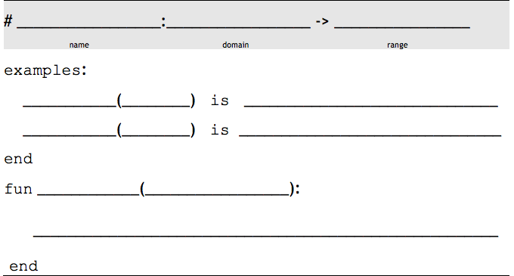
The Design Recipe
triple
Number
Number
n
triple
6
6 * 3
triple
13
13 * 3
triple
n
n * 3

Slide 11
The Design Recipe
gt
Number
Image
size
gt
7
triangle(7, “solid”, “green”)
gt
22
triangle(22, “solid”, “green”)
gt
size
triangle(size, “solid”, “green”)
Notes:
Closing: you’ve gotten familiar with Pyret syntax, for those familiar with BS1, the design recipe still works, and for those of you who weren’t, you’ll get very familiar with DR soon.

Slide 12
Unit 2

Slide 13
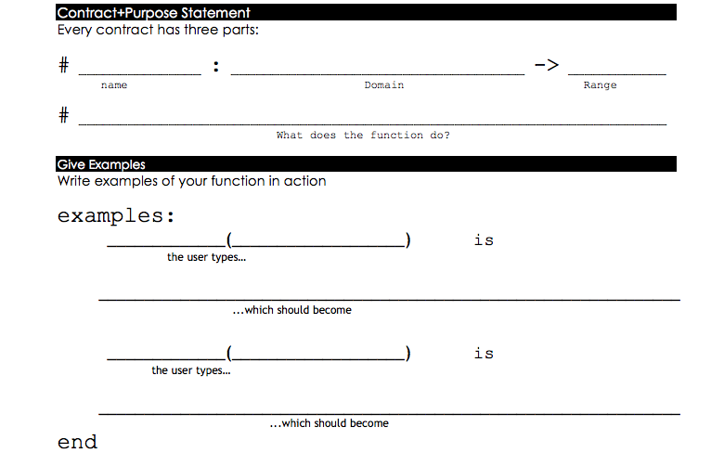
double-radius
Number, String
Image
Consumes a radius and color, produces an outlined circle of the given color whose radius is twice the given number
color
double-radius
30, “red”
radius
circle( 30 * 2, “outline”, “red”)
double-radius
7, “purple”
circle( 7 * 2, “outline”, “purple”)

Slide 14
Introducing put-image
# put-image : Image, Number, Number, Image -> Image
# image-width : Image -> Number
# image-height : Image -> Number
# flip-horizontal : Image -> Image
# flip-vertical : Image -> Image
# scale : Number, Image -> Image
# rotate : Number, Image -> Image

Slide 15
Parachute Jumper
What datatype should my range be?
Number? String? Image? Boolean?
Introducing Coords…
# coord : Number, Number → Coord
Coords are just another value…
Notes:
4 data types you already know about, can you use them to return two things? Is a number good for this? String? Image? None of these things will work for this task, but we have a way of combining things: structures. BS1 teachers, this is an upgrade to our language- new concept that we didn’t see in BS1- NEW STUFF!!!
try making some coords, see what happens, THEN talk about capitalization

Slide 16
next-position
Number, Number
Coord
Given an x and y, produces a Coord with x + 5 and y - 5
y
next-position
33, 70
x
coord(33 + 5, 70 – 5)
next-position
8, 20
coord(8 + 5, 20 – 5)

Slide 17
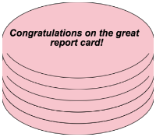
Your Bakery
Flavor
Color
Message
Number of layers
Whether or not the cake is an ice cream cake
Notes:
What data type would you use to represent each of these aspects of a Cake?

Slide 18
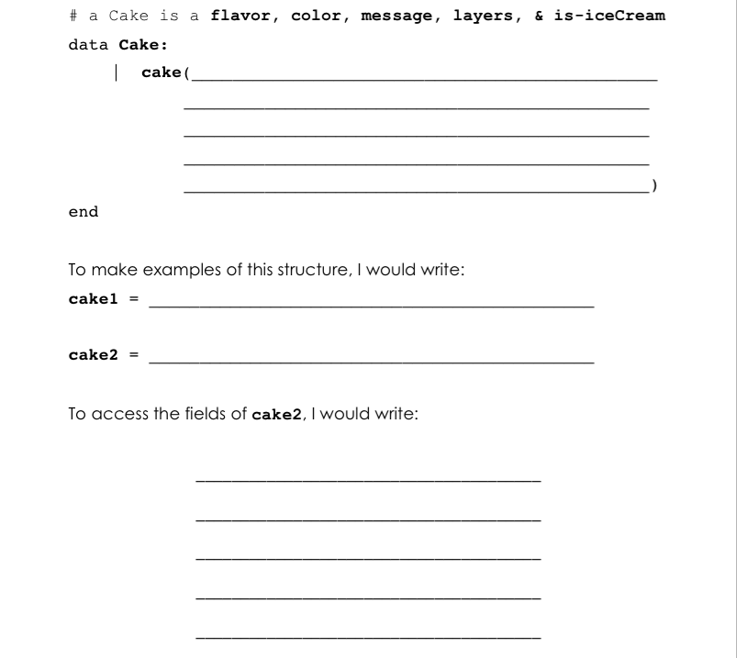
flavor :: String,
color :: String,
message :: String,
layers :: Number,
is-iceCream :: Boolean
cake(“vanilla”, “white”, “Happy wedding!”, 4, false)
cake(“chocolate”, “brown”, “Happy birthday!”, 8, false)
cake2.flavor
cake2.color
cake2.message
cake2.layers
cake2.is-iceCream
Notes:
NEW SYNTAX!!!
Data block, listing the name of the field and the type of the field, separated by two colons

Slide 19
Unit 3

Slide 20
cake-price
Cake
Number
Consumes a Cake and produces the price of that cake. Cakes cost $20, plus $5 per extra layer
cake-price
cake1
a-cake
(20 + ( cake1.layers * 5)) - 5
cake-price
cake2
(20 + (cake2.layers * 5)) - 5

Slide 21
will-melt
Cake, Number
Boolean
Consumes a Cake and temp, asks if the temp is greater than 32 degrees AND if the Cake is an ice cream cake
temp
will-melt
cake1, 75
a-cake
(75 > 32) and cake1.is-iceCream
will-melt
cake2, 29
(29 > 32) and cake2.is-iceCream
Notes:
‘and’ should be written infix

Slide 22
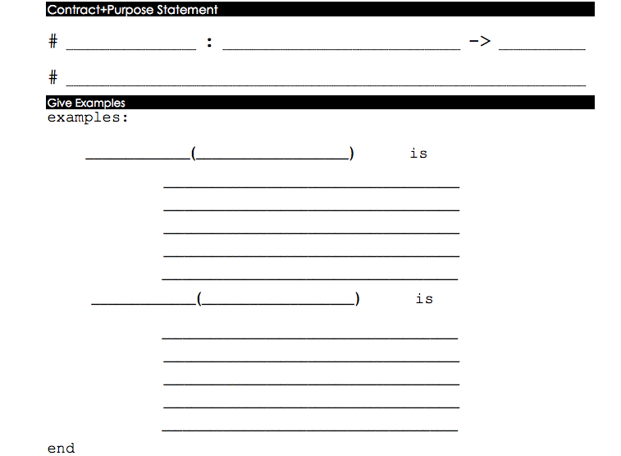
change-flavor
Cake, String
Cake
Consumes a Cake and flavor, produces a Cake the same as the original, but with the given flavor
change-flavor
cake1, “strawberry”
new-flavor
cake(
“strawberry”,
cake1.color,
cake1.message,
a-cake
cake1.layers,
cake1.is-iceCream)
change-flavor
cake2, “mint chocolate”
cake(
“mint chocolate”,
cake2.color,
cake2.message,
cake2.layers,
cake2.is-iceCream)

Slide 23
Data Structures: Party
Open a new Pyret file
Write the data definition for Party
Define a new structure of your own!

Slide 24
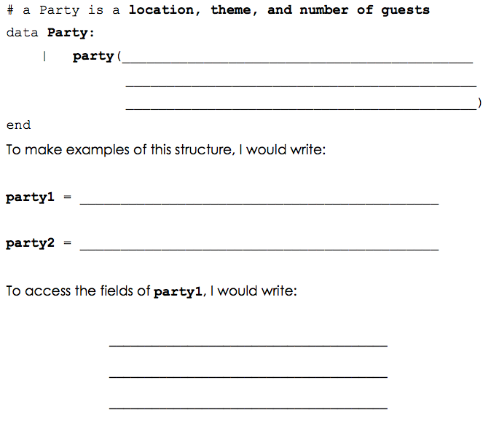
location :: String,
theme :: String,
guests :: Number
party(“Colorado”, “Bootstrap”, 16)
party(“My house”, “Birthday”, 200)
party1.location
party1.theme
party1.guests

Slide 25
Unit 4

Slide 26

10 20 30 40 50 60 70 80 90 100 110 120 130 140 150

Slide 27
The Pieces of an Animation
In the “Intro to Big Bang” file, find the pieces of code that correspond to each of the following concepts:
The information that changes during the animation
The function that creates images for the animation
The function that updates data for the next frame
Starting the mediator

Slide 28
Brainstorm: Single Number World
Imagine that you have a world consisting of just a single number.
Brainstorm what animations you could create with this data. What could that number represent?

Slide 29
Brainstorm: Two Number World
Imagine that you have a world consisting of just two numbers.
Brainstorm what animations you could create with this data. What could those numbers represent?

Slide 30
Unit 5

Slide 31
Luigi’s Pizza
What does cost(“cheese”) evaluate to?
What will happen for cost(“onion”)?
What is this function doing?
Add “mushroom” to the menu, for $11.99
Change the code to add your favorite topping!
Change the code to charge customers $1000.00 for anything not on the menu

Slide 32
Keypress: Ninja Cat
Open the Ninja World 3 file
Can you make Ninja Cat move down as well?
Can you make Ninja Cat move left and right?
Turn to page 22: What keys control your game?

Slide 34
Unit 6

Slide 35
Keypress: Your Game
A new event-handler!
on-key(keypress)
Challenges:
Warping
Boundary detection
Wrapping
Hiding

Slide 36
Unit 7

Slide 37
Asking the World
Strong-password
# > : Number, Number → Boolean
# < : Number, Number → Boolean

Slide 38
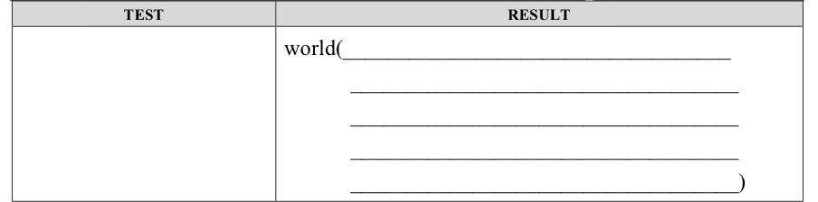
Helper functions
is-off-right(w.dogX)
0, w.coinX - 5, w.catX,
w.catY

Slide 39
Collision Detection

Slide 40
Unit 8

Slide 41
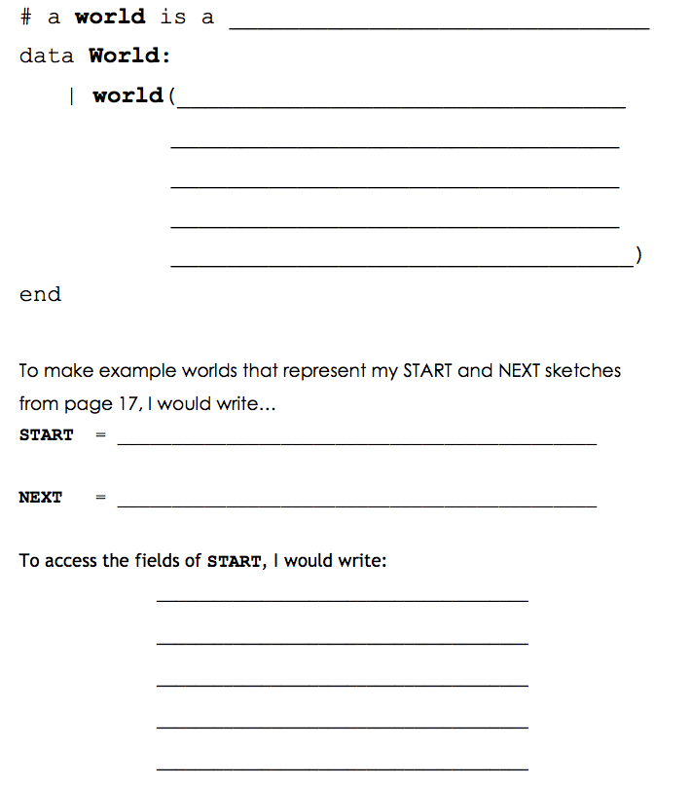

Slide 42
Your Game
Open the BS:2 Blank Game template
Using Pages 17 and 18, define your World structure and two example Worlds (try START and NEXT!)
Take 10 minutes to find game images and use image-url to put them in the GRAPHICS section

Slide 43
Steps to Make a Game
SLIDE: Steps to make a game- outline for the progress of a game throughout the workshop so teachers know the general progression

Slide 44
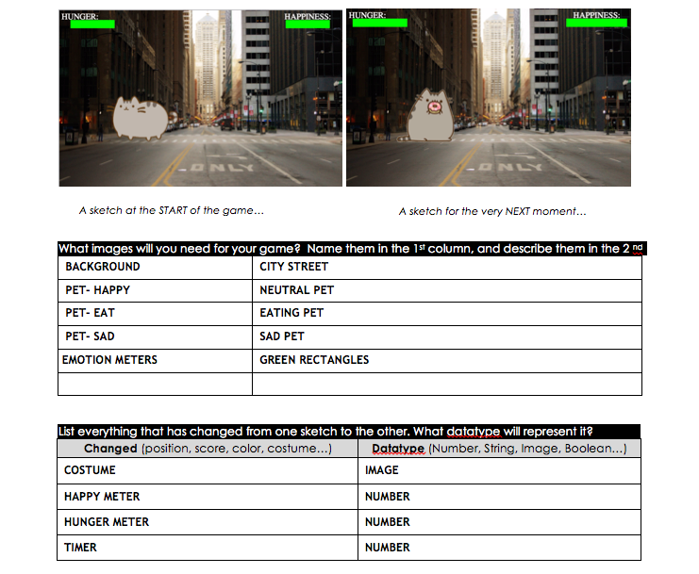

Slide 45
Unit 9

Slide 46
Piecewise Functions in Your Game

Slide 47
Unit 10

Slide 48
Collision Detection in Your Game

Slide 49
Implementation

Slide 50


Thank You
Facebook.com/BootstrapWorld
@Bootstrapworld

